Slide 1
SOS Hotel Search
Creators: Flornaldine Pierre, Chris Bicknese, Robbie Darrow, Allen Telson, Alex Sanchez

Slide 2
Roles in Prototype Development
Login and Register: Flora
Dashboard: Robbie and Alex
Map and Search: Robbie and Allen
Hotel name view: Alex
Payment info: Flora
Sequence diagram: Chris

Slide 3
Summary of Project
Java-based application that provides the user with a built-in search engine that meets the user’s need to find the ideal hotel for their next trip.
Filtered search option based on their choices of price, location, size, and more.
Map feature where users will be able to interact with the map to explore hotel options.
Application will include features such as accounts to help differentiate between consumers and hotel owners or representatives that want to look and respond to reviews and feedback from consumers.
The user will be able to reserve their hotel, choose the dates of the trip and pay for the total price of the trip.

Slide 4
Functionalities
Create account: allow user to create account.
Login: allow the user to enter their username and password to login.
Search hotels: allow user to enter location information to search for hotels in that area.
View reviews: allow user to view reviews of hotels on the hotel information page.
View reviews: allow user to view reviews of hotels on the hotel information page.
Write reviews: allow user to write a review for a hotel.
View reservations: allows hotel owners to view all reservations for their hotel and hotel users to view their reservations.
Cancel reservation: allows users to cancel a reservation up to 24 hours after booking.
Save hotel: allow user to add hotel to a list of saved hotels.

Slide 5
Schedule
10/15 - 10/22: Work on prototype.
11/1 - 11/8: Add more screens to prototype.
11/15 - 11/22: Add functionality and work on back-end.
11/22 - 12/1: Finalize project.

Slide 6
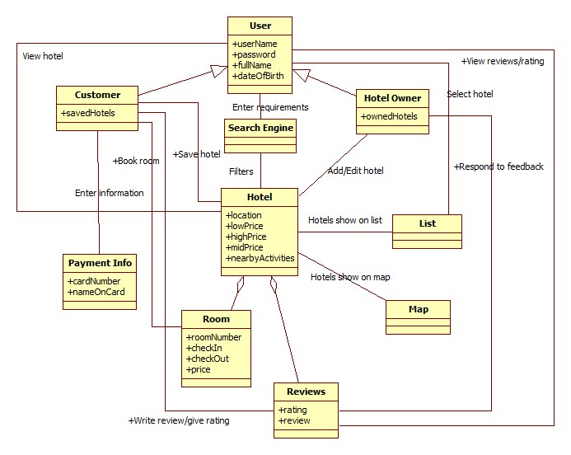
Class Diagram

Slide 7
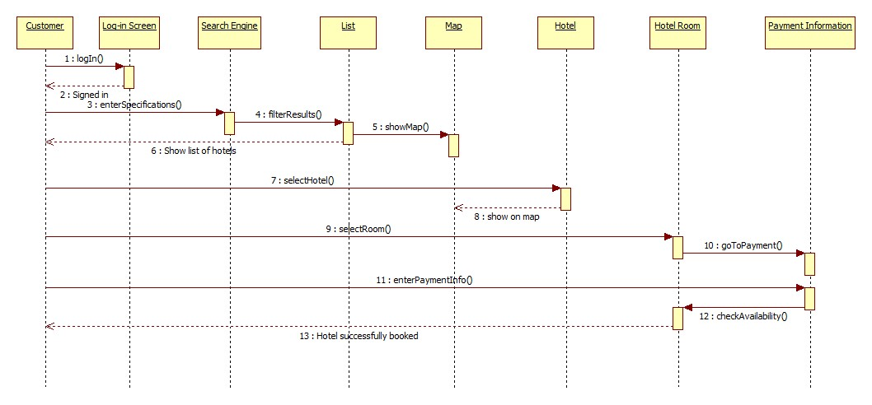
Sequence Diagram

Slide 8
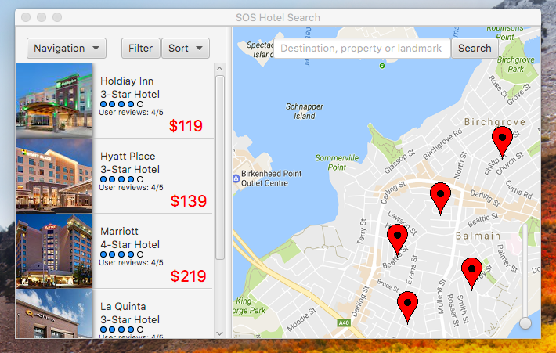
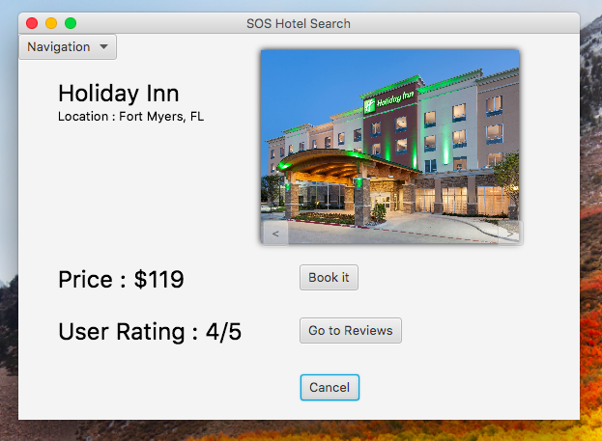
Screenshots
Dashboard
https://youtu.be/GW5Kq2l_ilg
Hotel Info Screen

Slide 9
Next Steps
Add more screens.
Add functionality with back-end.
Challenges: Finalizing project.
Decisions: Decide who will focus on front-end over back-end.

